Slide 1
4 Places and directions

Slide 2
4 Places and directions
In this unit you will practise:
understanding a description of a place
following directions
labelling a map
multiple choice

Slide 3
4 Places and directions - Describing a place
1 Describing a place
For some questions in the Listening paper you need to look at a map of a place or a plan of a building.

Slide 4
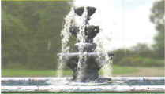
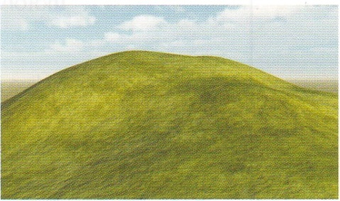
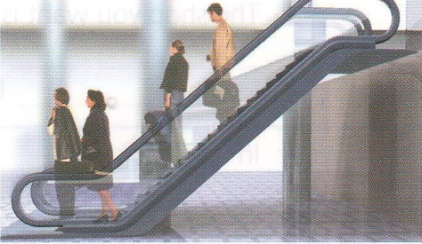
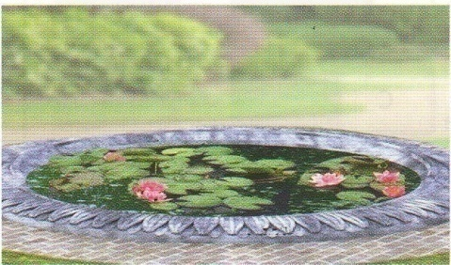
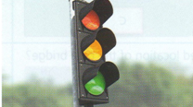
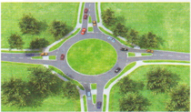
4 Places and directions - Describing a place
1.1 Look at drawings A-F and decide what the images are.
A
B
C
an escalator
a fountain
a hill
D
E
F
a pond
traffic lights
a roundabout

Slide 5
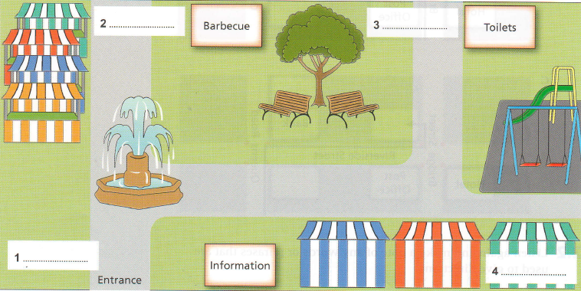
4 Places and directions - Describing a place
1.2 Study the map in section 3.3 for 30 seconds.
Brookside Market

Slide 6
4 Places and directions - Describing a place
1.3 Try to answer questions 1-4 without looking back at the map.
1 What is it a map of?
2 Name three landmarks on the map.
3 There is the entrance?
4 What is in the centre of the map?
Features already on the map are often used as landmarks to help you find your way.
a market
a tree, a fountain, a play area (swings)
at the bottom on the left
a tree

Slide 7
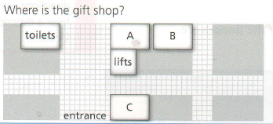
4 Places and directions - Describing a place
1.4 Listen to tracts from the four sections of the listening test. Complete the first column in the table by choosing the correct letter (A, B or C).
16
 |  | Landmard(s) | Locating words /phrases
1 | Where is the gift shop? | lifts | The entrance is ________ Then go ________ The shop you want is _______ ________lifts
A

Slide 8
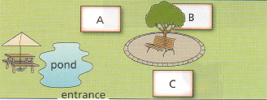
4 Places and directions - Describing a place
1.4 Listen to tracts from the four sections of the listening test. Complete the first column in the table by choosing the correct letter (A, B or C).
16
 |  | Landmard(s) | Locating words /phrases
2 | Where can you buy stamps? |  | In ____ resort, you’ll see a … _____ courtyard, you’ll find a … It’s just _____tree
B

Slide 9
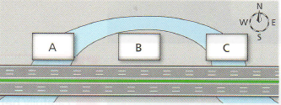
4 Places and directions - Describing a place
1.4 Listen to tracts from the four sections of the listening test. Complete the first column in the table by choosing the correct letter (A, B or C).
16
 |  | Landmard(s) | Locating words /phrases
3 | What is the proposed location of the new bridge? |  | I was thinking of putting it _______ I think it would be better if it's _______ motorway
C

Slide 10
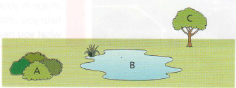
4 Places and directions - Describing a place
1.4 Listen to tracts from the four sections of the listening test. Complete the first column in the table by choosing the correct letter (A, B or C).
16
 |  | Landmard(s) | Locating words /phrases
4 | Where is the ideal habitat for the traviston Frog? |  | … it is unable to live in ______ of a pond …. it does need to live in ______ to water … in a tiny burrow ______ bushes
A

Slide 11
4 Places and directions - Describing a place
1.5 Listen again and complete the table on the previous page. Write down the landmarks mentioned and fill in the gaps in the phrases that help you to locate the correct answer.
16
 |  | Landmard(s) | Locating words /phrases
1 | Where is the gift shop? | lifts | The entrance is ________ Then go ________ The shop you want is _______ ________the lifts
entrance, toilets
over there on your left
straight ahead
opposite the toilets
Next to

Slide 12
4 Places and directions - Describing a place
1.5 Listen again and complete the table on the previous page. Write down the landmarks mentioned and fill in the gaps in the phrases that help you to locate the correct answer.
16
 |  | Landmard(s) | Locating words /phrases
2 | Where can you buy stamps? |  | In ____ resort, you’ll see a … _____ courtyard, you’ll find a … It’s just _____tree
circular courtyard, entrance, tree
the middle of the
To the right of the
behind the

Slide 13
4 Places and directions - Describing a place
1.5 Listen again and complete the table on the previous page. Write down the landmarks mentioned and fill in the gaps in the phrases that help you to locate the correct answer.
16
 |  | Landmard(s) | Locating words /phrases
3 | What is the proposed location of the new bridge? |  | I was thinking of putting it _______ I think it would be better if it's _______ motorway
river, motorway
right in the middle
at the eastern end of the

Slide 14
4 Places and directions - Describing a place
1.5 Listen again and complete the table on the previous page. Write down the landmarks mentioned and fill in the gaps in the phrases that help you to locate the correct answer.
16
 |  | Landmard(s) | Locating words /phrases
4 | Where is the ideal habitat for the traviston Frog? |  | … it is unable to live in _________ of a pond …. it does need to live in ______ to water … in a tiny burrow ______ bushes
bushes, pond, tree
the area
fairly close proximity
surrounded by

Slide 15
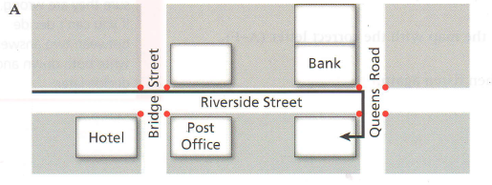
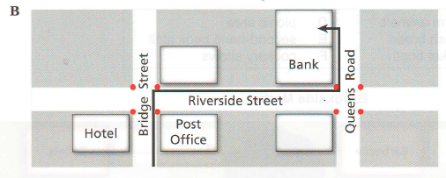
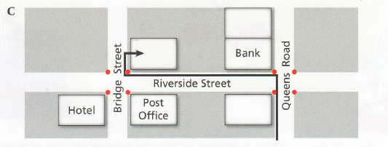
4 Places and directions - Following directions
2 Following directions
2.1 Listen and decide which diagram (A, B or C) shows the directions described by the speaker.
17
B

Slide 16
4 Places and directions - Describing a place
2.2 Listen again and make a note of any words or phrases that are used to give directions.
We’re in Bridge Street now and it’s in Queens Road.
You need to go up Bridge Street as far as the traffic lights, then turn right.
Then you walk along there to the next set of traffic lights and you’ll be at Queens Road. You turn left there and it’s the second shop on your left.
17

Slide 17
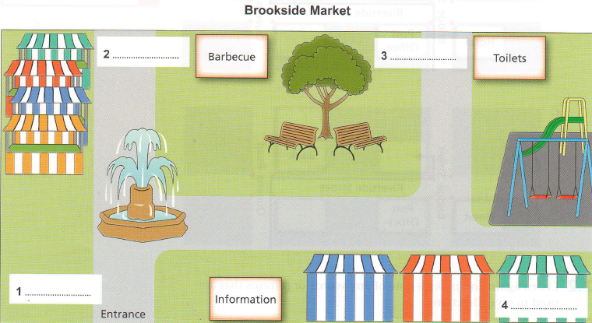
4 Places and directions - Labelling a map
3 Labelling a map
Sometimes a map completion task asks you to identify an area on a map then choose an answer from a list. For this type of question you need to familiarise yourself with both the list of options and the features on the map before you start.

Slide 18
4 Places and directions - Labelling a map
3.1 Look at this map completion task. Which landmarks might be used to help you to find your way around?
Useful landmarks:
information
the entrance
the toilets
the barbecue
the tree
the playground

Slide 19
4 Places and directions - Labelling a map
3.2 Check your answers, then listen again.
Questions 1-4
Label the map below.
Choose the correct letter A – F and write the answers next to questions 1-4.
18
A farm animals D picnic area B fresh bread E second-hand book stall C ticket booth F cookery shows

Slide 20
4 Places and directions - Labelling a map
3.2 Listen and label the map with the correct letter (A – F).
18
B
D
F
A

